Slide 1

Algorithm Analysis I
Runtime analysis as a process: comprehending programs, modeling the number of steps, and formulating an answer.
Kevin Lin, with thanks to many others.
Notes:
Ask questions anonymously on Piazza. Look for the pinned Lecture Questions thread.

Slide 2
Feedback from the Reading Quiz
Demo
Counting operations. Let’s look at an example where N = 6 instead of N = 10000.
Confusing question. What part of dup1 and dup2 required us to specify a range for the number of times an operation was executed?
Parabolas vs. lines.

Slide 3
Runtime Analysis Process
Comprehending. Understanding the implementation details of a program.
Modeling. Counting the number of steps in terms of N, the size of the input.
Case Analysis. How certain conditions affect the program execution.
Asymptotic Analysis. Describing what happens for very large N, as N→∞.
Formalizing. Summarizing the final result in precise English or math notation.
Consider every pair
boolean dup1(int[] A)
Best case
Worst case
Array contains a duplicate at front
Array contains no duplicate items
Constant time
Quadratic time
Θ(1)
Θ(N²)
Overall Asymptotic Runtime Bound
Notes:
The reading described the implementation details for dup1 and dup2 (Comprehension) and introduced the idea of counting steps (Modeling). In this lecture, we will go in-depth on modeling and formalizing.
?: Where did case analysis come up in the reading?

Slide 4
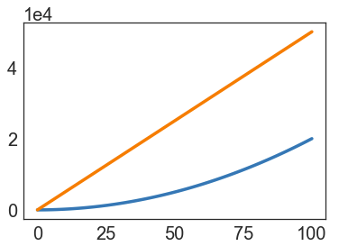
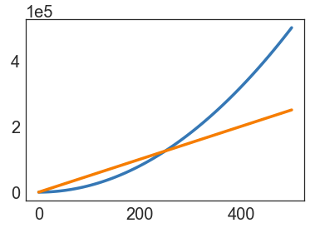
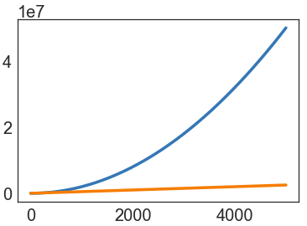
Asymptotic Analysis
What happens for very large N, as N→∞.
Simulating billions of particles.
Social network with billions of users.
Logging billions of transactions.
Encoding billions of bytes of video data.
Linear-time algorithms scale better than quadratic-time algorithms (parabolas).
Notes:
From this point forward, we’ll almost always be working in the mode of asymptotic analysis: considering the behavior of programs as N grows very large.
?: How can we characterize the range of step counts that we saw in dup1 and dup2?

Slide 5
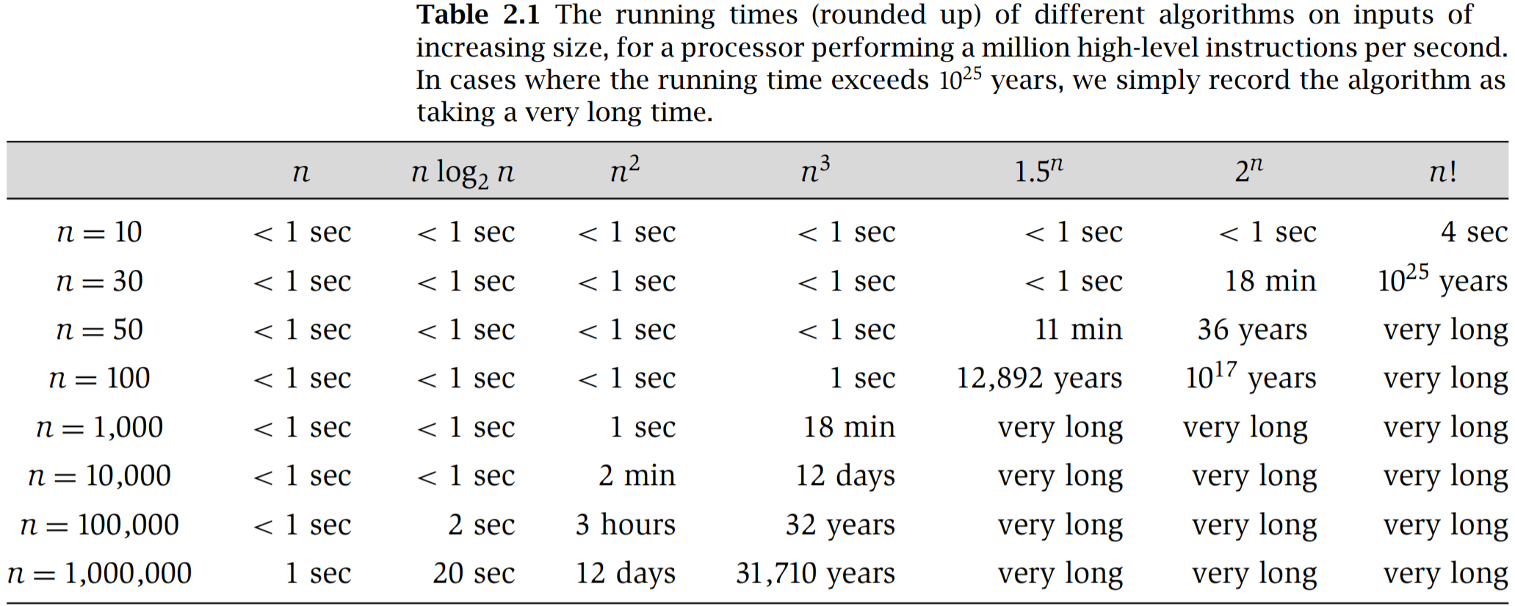
Orders of Growth
Algorithm Design (Jon Kleinberg, Éva Tardos/Pearson Education)
Notes:
?: Why might we choose to focus on very large N rather than small N?
?: How do multiplicative constants, e.g. 100N or N² / 2, affect the order of growth of the runtime of different algorithms?

Slide 6
Asymptotic Analysis and Case Analysis
Q
For a very large array with billions of elements (i.e. asymptotic analysis), is it possible for dup1 to execute only 2 less-than (<) operations?
Operation | dup1: Quadratic/Parabolic | dup2: Linear
i = 0 | 1 | 1
less-than (<) | 2 to (N² + 3N + 2) / 2 | 1 to N
increment (+= 1) | 0 to (N² + N) / 2 | 0 to N - 1
equality (==) | 1 to (N² - N) / 2 | 1 to N - 1
array accesses | 2 to N² - N | 2 to 2N - 2
Notes:
public static boolean dup1(int[] A) {
for (int i = 0; i < A.length; i += 1) {
for (int j = i + 1; j < A.length; j += 1) {
if (A[i] == A[j]) {
return true;
}
}
}
return false;
}
Q1: For a very large array with billions of elements (i.e. asymptotic analysis), is it possible for dup1 to execute only 2 less-than (<) operations?
?: What does the runtime for dup1 vs. dup2 look like if we only consider the best case asymptotic analysis? How does that result compare to the worst case asymptotic analysis?

Slide 7
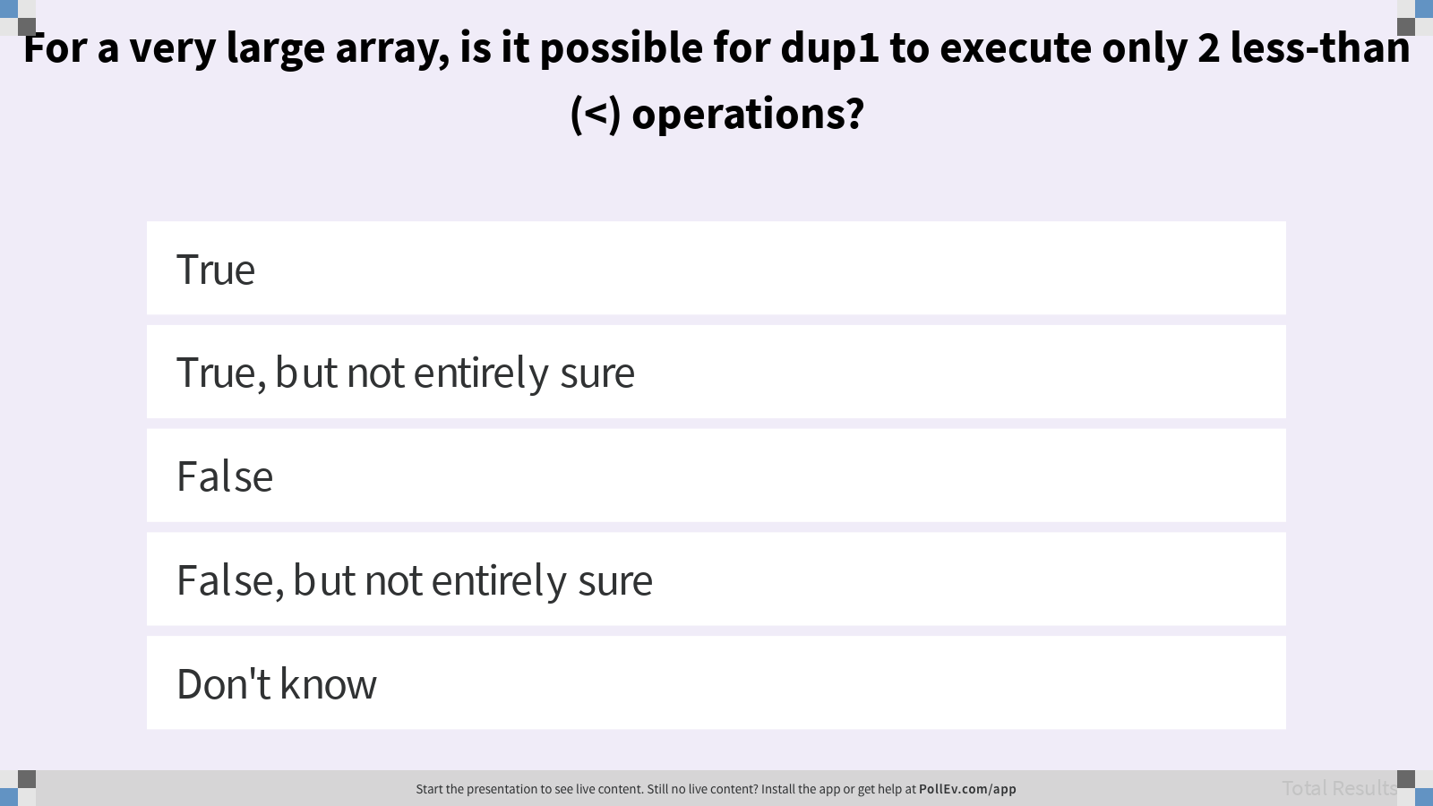
For a very large array, is it possible for dup1 to execute only 2 less-than (<) operations?

Slide 8

Duplicate Finding
Our goal is to somehow characterize the runtimes of the functions below.
Characterization should be simple and mathematically rigorous.
Characterization should demonstrate superiority of dup2 over dup1.
Operation | dup1: Quadratic/Parabolic | dup2: Linear
i = 0 | 1 | 1
less-than (<) | 2 to (N² + 3N + 2) / 2 | 1 to N
increment (+= 1) | 0 to (N² + N) / 2 | 0 to N - 1
equality (==) | 1 to (N² - N) / 2 | 1 to N - 1
array accesses | 2 to N² - N | 2 to 2N - 2

Slide 9
Worst Case Order of Growth
Notes:
If we only need a worst case order of growth runtime analysis (often what people talk about as runtime analysis in the real world), then we can significantly simplify the Modeling process. In exchange for removing detail from our model, we get a quick way to characterize a program’s asymptotic behavior.

Slide 10
Simplification 1: Consider Only the Worst Case
Provides a runtime guarantee for any input of size N.
We often only care about worst case, but there are many exceptions.
public static boolean dup1(int[] A) {
for (int i = 0; i < A.length; i += 1) {
for (int j = i + 1; j < A.length; j += 1) {
if (A[i] == A[j]) {
return true;
}
}
}
return false;
}
Operation | Worst Case: dup1
i = 0 | 1
j = i + 1 | 1 to 10000
less-than (<) | 2 to (N² + 3N + 2) / 2
increment (+= 1) | 0 to (N² + N) / 2
equality (==) | 1 to (N² - N) / 2
array accesses | 2 to N² - N
Notes:
?: What are real-world scenarios where the worst-case runtime is important? Scenarios where it isn’t important?

Slide 11
Identifying Orders of Growth
Q
Consider the algorithm step counts below.
What do you expect will be the order of growth of the runtime for the algorithm?
N [linear]
N² [quadratic]
N³ [cubic]
N⁶ [sextic]
Operation | Count
less-than (<) | 100N² + 3N
greater-than (>) | 2N³ + 1
and (&&) | 5,000
Notes:
Q1: What do you expect will be the order of growth of the runtime for the algorithm? In other words, if we plotted total runtime vs. N, which curve would we expect?

Slide 12
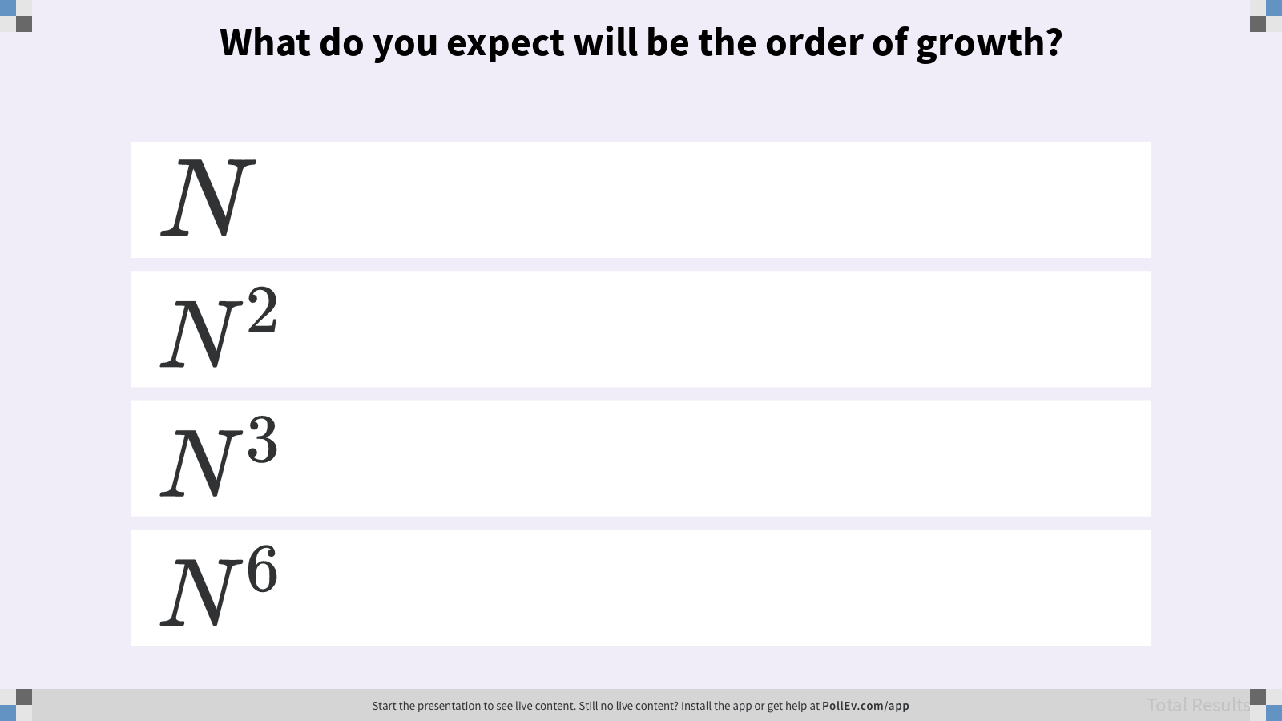
What do you expect will be the order of growth?

Slide 13
Simplification 2: Restrict Attention to One Operation
Pick some representative operation to act as a proxy for the overall runtime.
Good choices:
Less-than (<)
Increment (+= 1)
Equality (==)
Array accesses
Poor choices: assignment of i = 0 or j = i + 1.
We call our choice the cost model.
Operation | Worst Case: dup1
i = 0 | 1
j = i + 1 | 10000
less-than (<) | (N² + 3N + 2) / 2
increment (+= 1) | (N² + N) / 2
equality (==) | (N² - N) / 2
array accesses | N² - N
Notes:
Note that this assumes that the runtime cost of each instruction is the about the same, so 100 array accesses takes the same amount of time as 100 increment operations. This is a lie: in modern computers, a single array access can take the same amount of time as 100 or more increment operations.
?: What part of worst case order of growth analysis makes it acceptable to rely this lie?
?: How do we pick a representative operation? What are the qualities of good choices vs. poor choices?

Slide 14
Simplification 3: Eliminate Lower-Order Terms
Ignore lower-order terms.
public static boolean dup1(int[] A) {
for (int i = 0; i < A.length; i += 1) {
for (int j = i + 1; j < A.length; j += 1) {
if (A[i] == A[j]) {
return true;
}
}
}
return false;
}
Operation | Worst Case: dup1
increment (+= 1) | (N² + N) / 2
Notes:
?: Why can we ignore lower-order terms?

Slide 15
Simplification 4: Eliminate Multiplicative Constants
Ignore multiplicative constants.
We already threw away the meaningful constant when we chose a single proxy operation.
public static boolean dup1(int[] A) {
for (int i = 0; i < A.length; i += 1) {
for (int j = i + 1; j < A.length; j += 1) {
if (A[i] == A[j]) {
return true;
}
}
}
return false;
}
Operation | Worst Case: dup1
increment (+= 1) | N² / 2

Slide 16
Simplification Summary
Only consider the worst case.
Pick a representative operation (cost model).
Ignore lower order terms.
Ignore multiplicative constants.
Operation | dup1
i = 0 | 1
j = i + 1 | 1 to 10000
less-than (<) | 2 to (N² + 3N + 2) / 2
increment (+= 1) | 0 to (N² + N) / 2
equality (==) | 1 to (N² - N) / 2
array accesses | 2 to N² - N
Order of growth
Operation | Worst Case Growth
increment (+= 1) | N²
“The worst case order of growth of the runtime for dup1 is N².”

Slide 17
Your Turn: Worst Case Order of Growth for dup2
Q
Only consider the worst case.
Pick a representative operation (cost model).
Ignore lower order terms.
Ignore multiplicative constants.
Operation | dup2
i = 0 | 1
less-than (<) | 1 to N
increment (+= 1) | 0 to N - 1
equality (==) | 1 to N - 1
array accesses | 2 to 2N - 2
Order of growth
Operation | Worst Case Growth
array accesses | N
Operation | Worst Case Growth
“The worst case order of growth of the runtime for dup2 is …”
Notes:
Q1: Determine the worst case order of growth for dup2.
Q2: Which operations are appropriate cost models? How do you know?

Slide 18
Simplified Modeling Process
Rather than building the entire table, we can instead:
Choose a representative operation to count (cost model).
Figure out the order of growth for the count of the representative operation by either:
Making an exact count and then discarding the unnecessary pieces.
After lots of practice, using inspection to determine order of growth.
Let’s redo our analysis of dup1 with this new process.
This time, we’ll show all our work.
Notes:
By using our simplifications from the outset, we can avoid building the table at all!

Slide 19

Worst Case Order of Growth: Exact Count of == Operations
i
0
1
2
3
4
5
 | == | == | == | == | ==
 |  | == | == | == | ==
 |  |  | == | == | ==
 |  |  |  | == | ==
 |  |  |  |  | ==
int N = A.length; // N == 6
for (int i = 0; i < N; i += 1)
for (int j = i + 1; j < N; j += 1)
if (A[i] == A[j])
return true;
return false;
0 1 2 3 4 5
j
“The worst case order of growth of the runtime for dup1 is N².”

Slide 20
Worst Case Order of Growth: Geometric Argument
i
0
1
2
3
4
5
 | == | == | == | == | ==
 |  | == | == | == | ==
 |  |  | == | == | ==
 |  |  |  | == | ==
 |  |  |  |  | ==
int N = A.length; // N == 6
for (int i = 0; i < N; i += 1)
for (int j = i + 1; j < N; j += 1)
if (A[i] == A[j])
return true;
return false;
0 1 2 3 4 5
j
“The worst case order of growth of the runtime for dup1 is N².”
Area of right triangle of side length N - 1.
Order of growth of area is N².

Slide 21
Runtime Analysis Process
“The worst case order of growth of the runtime for dup1 is N².”
Comprehending. Understanding the implementation details of a program.
Modeling. Counting the number of steps in terms of N, the size of the input.
Case Analysis. How certain conditions affect the program execution.
Asymptotic Analysis. Describing what happens for very large N, as N→∞.
Formalizing. Summarizing the final result in precise English or math notation.
Consider every pair
boolean dup1(int[] A)
Best case
Worst case
Array contains a duplicate at front
Array contains no duplicate items
Constant time
Quadratic time
Θ(1)
Θ(N²)
Overall Asymptotic Runtime Bound
Notes:
We’ve just figured out how to model the worst case order of growth in several different ways.

Slide 22
Runtime Analysis Process
“The worst case order of growth of the runtime for dup1 is N².”
Comprehending. Understanding the implementation details of a program.
Modeling. Counting the number of steps in terms of N, the size of the input.
Case Analysis. How certain conditions affect the program execution.
Asymptotic Analysis. Describing what happens for very large N, as N→∞.
Formalizing. Summarizing the final result in precise English or math notation.
Consider every pair
boolean dup1(int[] A)
Best case
Worst case
Array contains a duplicate at front
Array contains no duplicate items
Constant time
Quadratic time
Θ(1)
Θ(N²)
Overall Asymptotic Runtime Bound
Notes:
Now, we want to formalize the order of growth precisely. The math might seem daunting at first but the idea is exactly the same as the order of growth analysis. Using Big-Theta instead of order of growth does not change the way we analyze algorithms at all.

Slide 23
Order of Growth Exercise
Q
Informally, what is the shape of each function for very large N?
In other words, what is the order of growth of each function?
Function | Order of Growth
N³ + 3N⁴
(1 / N) + N³
(1 / N) + 5
Ne^{N} + N
40 sin(N) + 4N²
Function | Order of Growth
N³ + 3N⁴ | N⁴
(1 / N) + N³ | N³
(1 / N) + 5 | 1
Ne^{N} + N | Ne^{N}
40 sin(N) + 4N² | N²
Notes:
Q1: Informally, what is the shape of each function for very large N? In other words, what is the order of growth of each function?

Slide 24

Big-Theta Notation
Suppose we have a function R(N) with order of growth f(N). In Big-Theta, we write this as:
Function | Big-Theta
N³ + 3N⁴ | Θ(N⁴)
(1 / N) + N³ | Θ(N³)
(1 / N) + 5 | Θ(1)
Ne^{N} + N | Θ(Ne^{N})
40 sin(N) + 4N² | Θ(N²)
Notes:
The ∈ symbol reads in English as “element of” so you could read the statement as “R(N) is an element of the set of functions with order of growth f(N).”

Slide 25

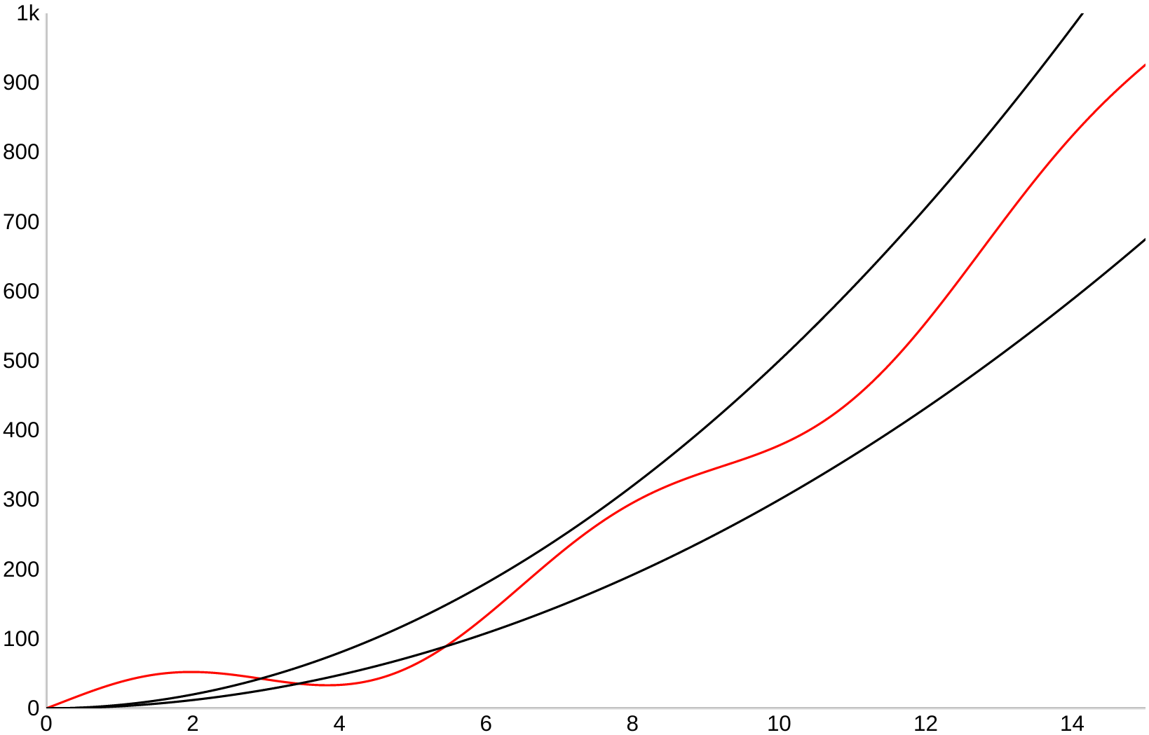




Big-Theta Definition
means there exist positive constants k₁ and k₂ such that
for all values of N greater than some N₀.
“Very large N”
Notes:
?: What is a value that we can choose for N₀ according to the plot on the right?

Slide 26
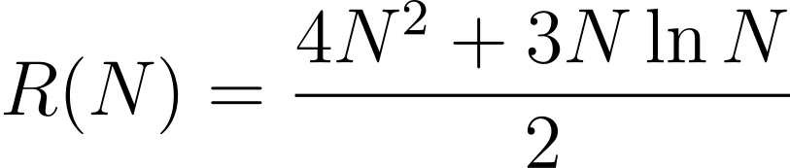
Big-Theta Challenge
Q
Demo
Find a simple f(N) and corresponding k₁ and k₂.
means there exist positive constants k₁ and k₂ such that
for all values of N greater than some N₀.
Notes:
Q1: Find a simple f(N) and corresponding k₁ and k₂.

Slide 27
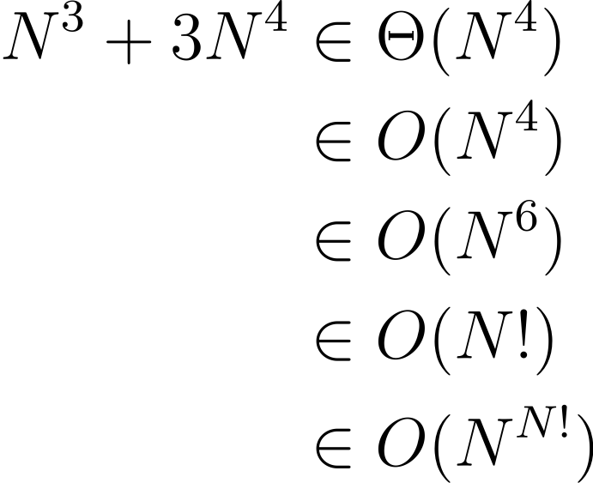
Big-O Notation
Whereas Big-Theta can informally be thought of as something like “equals”, Big-O can be thought of as “less than or equal”.
All of the following are true.

Slide 28

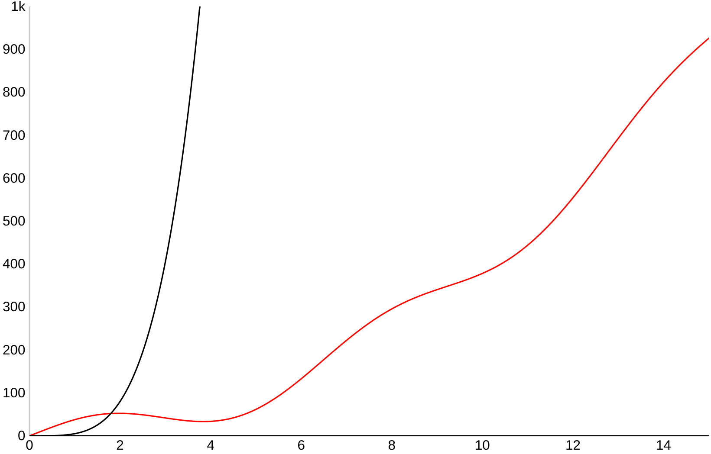

Big-O Definition
means there exists a positive constant k₂ such that
for all values of N greater than some N₀.
“Very large N”
Notes:
?: Why can we say that 40 sin(N) + 4N² is in O(N⁴)? Explain in terms of the formal definition of Big-O.
?: Why is it incorrect to say that 40 sin(N) + 4N² is in Θ(N⁴)? Explain in terms of the formal definition of Big-Theta.

Slide 29

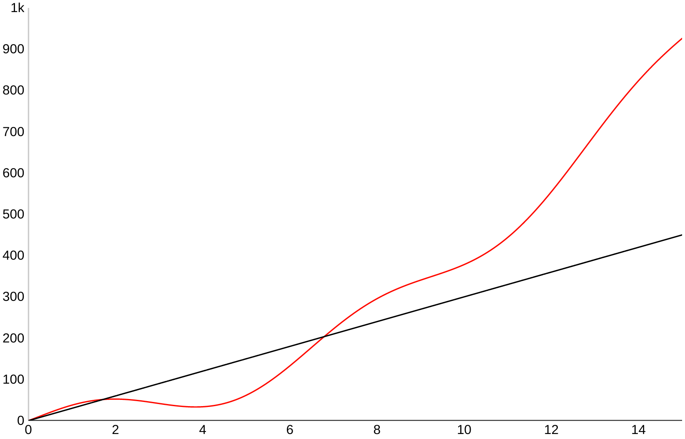


Big-Omega Definition
means there exists a positive constant k₁ such that
for all values of N greater than some N₀.
“Very large N”
Notes:
Likewise, we have a Big-Omega definition for the other half of the inequality.
?: Describe 40 sin(N) + 4N² ∈ Ω(N) in your own words using the plot on the right.
?: Does Θ(f(N)) imply O(f(N)) and Ω(f(N))? Does O(f(N)) and Ω(f(N)) imply Θ(f(N))?

Slide 30
Runtime Analysis Process
“The overall order of growth of the runtime for dup1 is …”
Comprehending. Understanding the implementation details of a program.
Modeling. Counting the number of steps in terms of N, the size of the input.
Case Analysis. How certain conditions affect the program execution.
Asymptotic Analysis. Describing what happens for very large N, as N→∞.
Formalizing. Summarizing the final result in precise English or math notation.
Consider every pair
boolean dup1(int[] A)
Best case
Worst case
Array contains a duplicate at front
Array contains no duplicate items
Constant time
Quadratic time
Θ(1)
Θ(N²)
Overall Asymptotic Runtime Bound
Notes:
Previously, we focused on stating formally, “The worst case order of growth of the runtime for dup1 is N².”
Now, let’s figure out how we can put it all together and state, “The overall order of growth of the runtime for dup1 is …”

Slide 31
Asymptotic Analysis and Case Analysis
For a very large array with billions of elements (i.e. asymptotic analysis), is it possible for dup1 to execute only 2 less-than (<) operations?
Operation | dup1: Quadratic/Parabolic | dup2: Linear
i = 0 | 1 | 1
less-than (<) | 2 to (N² + 3N + 2) / 2 | 1 to N
increment (+= 1) | 0 to (N² + N) / 2 | 0 to N - 1
equality (==) | 1 to (N² - N) / 2 | 1 to N - 1
array accesses | 2 to N² - N | 2 to 2N - 2
Notes:
In the best case there is a duplicate at the beginning of the very large array. A very large N (asymptotic analysis) doesn’t tell us anything about the contents of the array (case analysis).

Slide 32
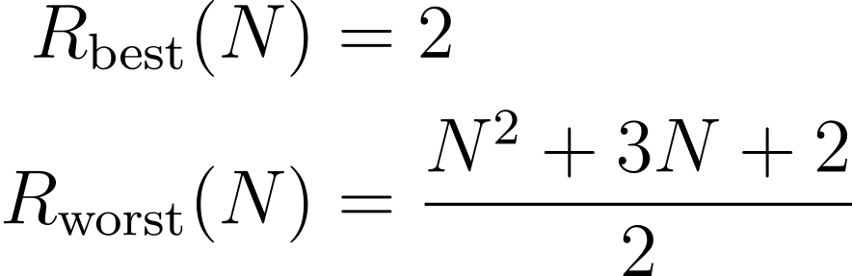
Overall Asymptotic Runtime Bound for dup1
Q
Demo
Give an overall asymptotic runtime bound for R as a combination of Θ, O, and/or Ω notation. Take into account both the best and the worst case runtimes (R_{best} and R_{worst}).
Notes:
Q1: Give an overall asymptotic runtime bound for R as a combination of Θ, O, and/or Ω notation. Take into account both the best and the worst case runtimes (R_{best} and R_{worst}).

